Slide 1
2023 Cyclistic Ride Data Case Study

Slide 2
Cyclistic Scenario
Cyclistic is a bike-share company in Chicago. The director of marketing believes the company’s future success depends on maximizing the number of annual memberships. Therefore, your team wants to understand how casual riders and annual members use Cyclistic bikes differently. From these insights, your team will design a new marketing strategy to convert casual riders into annual members. But first, Cyclistic executives must approve your recommendations, so they must be backed up with compelling data insights and professional data visualizations.

Slide 3
Stakeholders
Lily Moreno: The director of marketing
Cyclistic Executive Team: Team that will decide whether to approve the recommended marketing program
Cyclistic Marketing Analytics Team: Team of data analysts responsible for guiding Cyclistic marketing strategy

Slide 4
Main Business Task
Analyze how members and casual riders use Cyclistic bikes differently.
Provide recommendations to convert casual riders into annual members based on the findings.

Slide 5
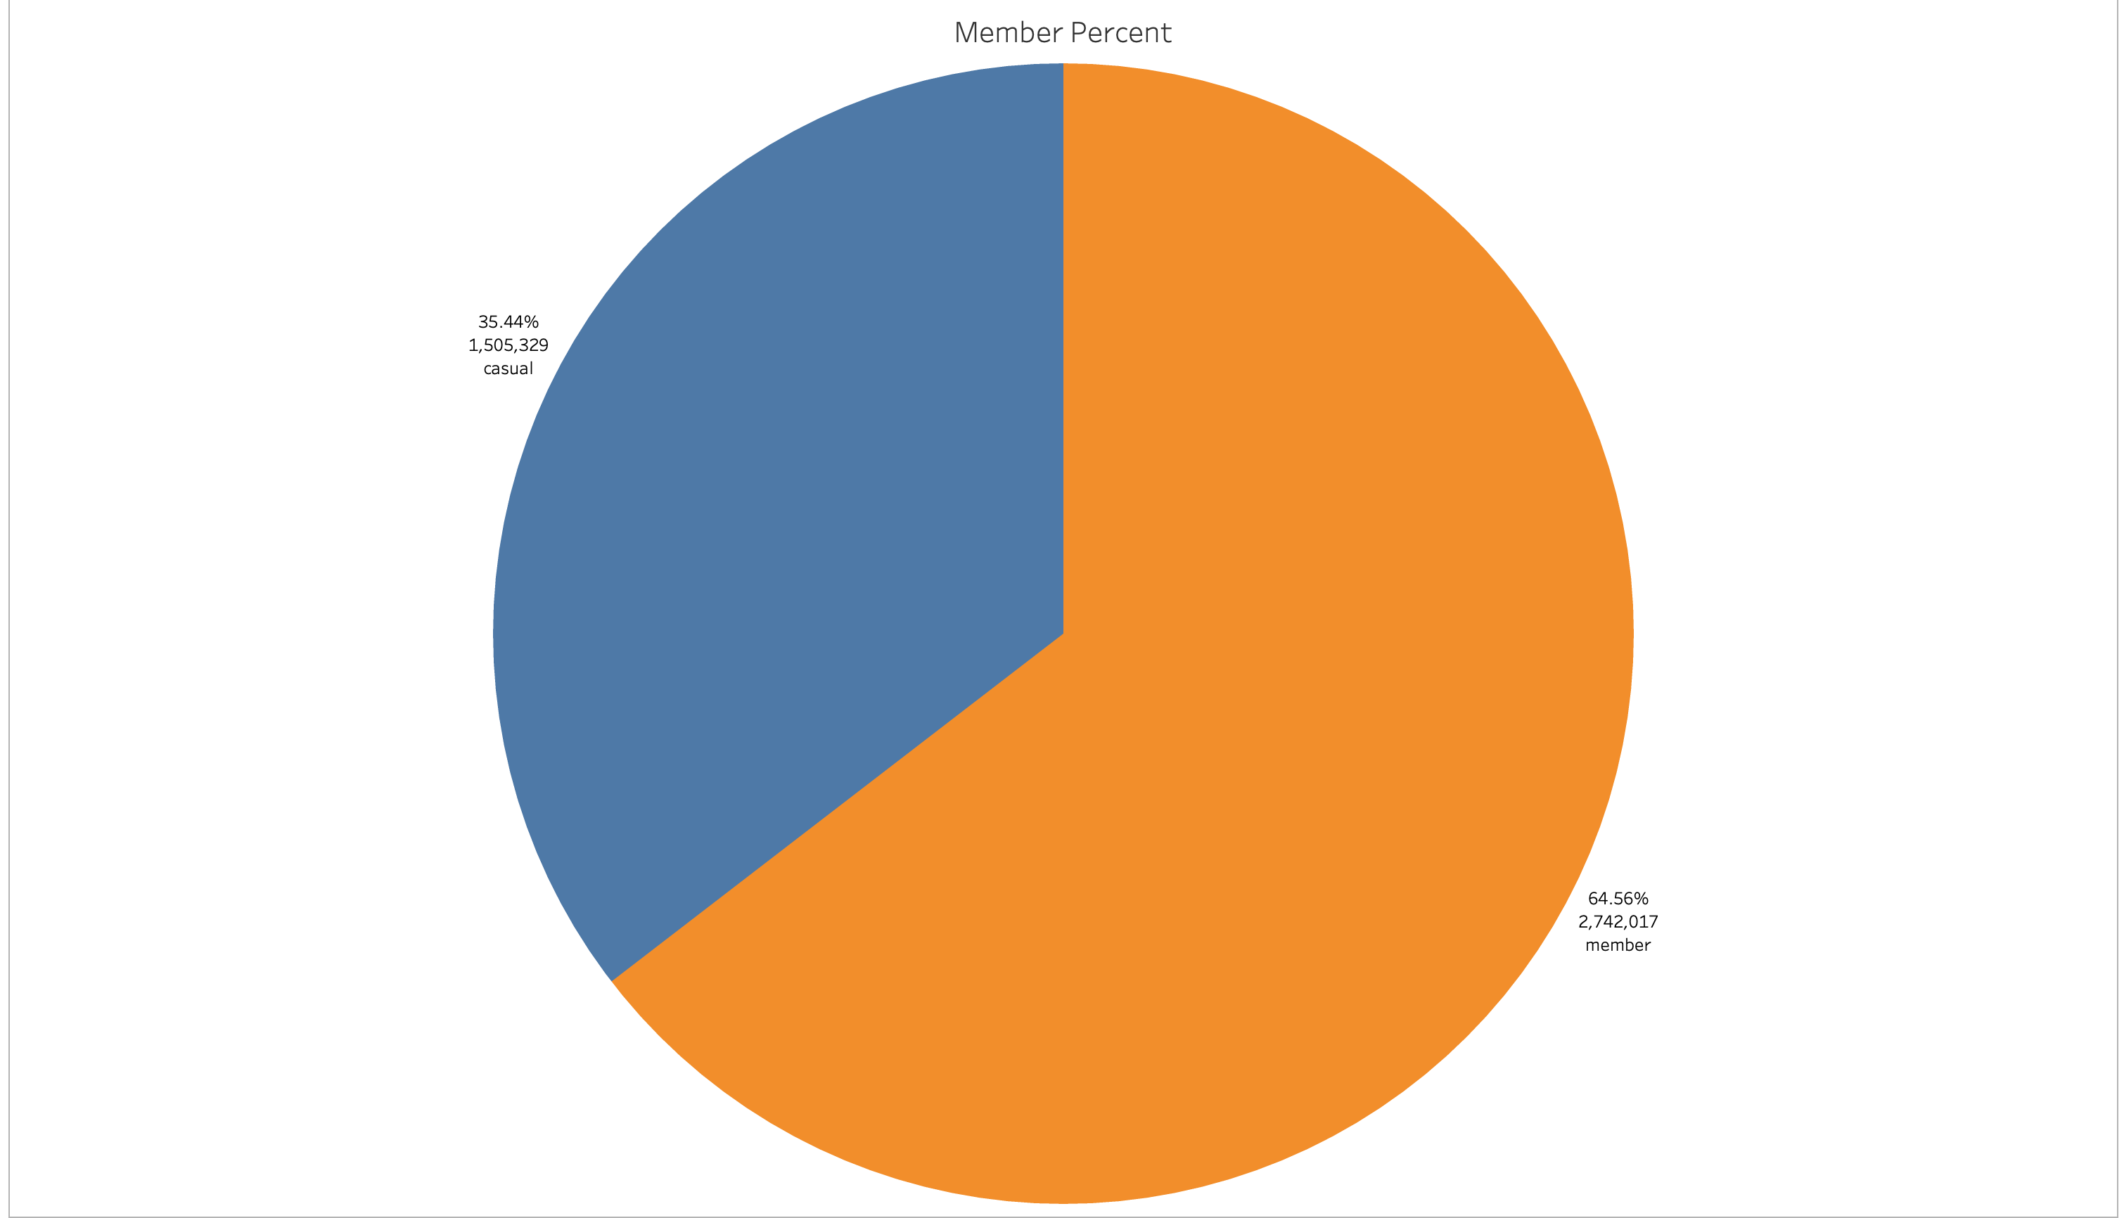
In 2023 approximately 2/3 of the rides were member rides
Out of 4,247,346 rides
Casual Rides made up 35.44% at 1,505,329
Member Rides made up 64.56% at 2742017

Slide 6
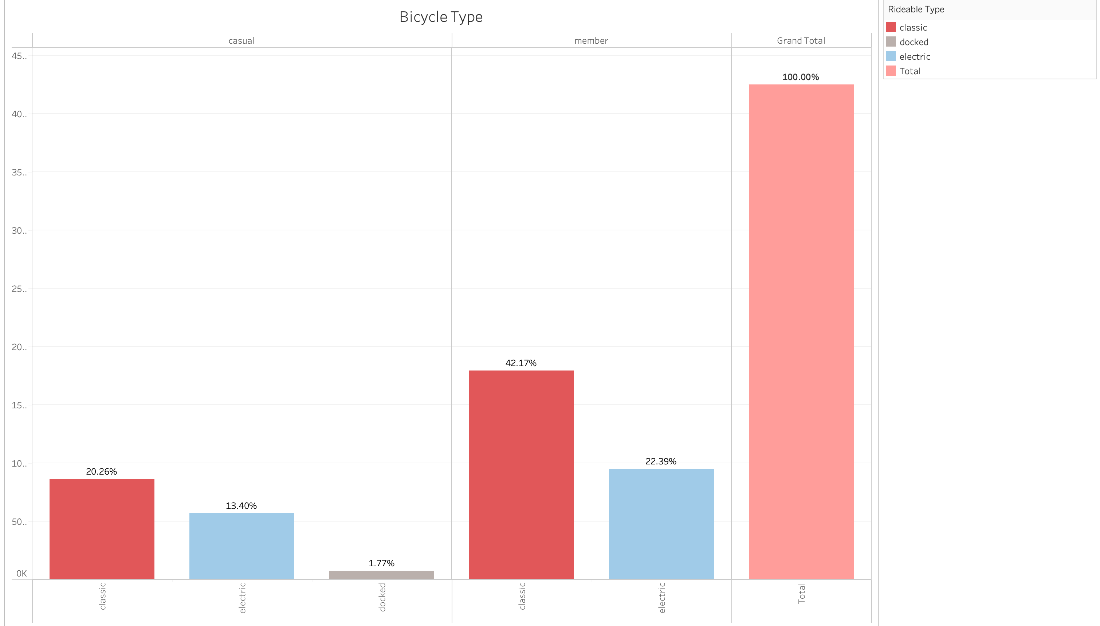
Both members and casual riders ride classic bikes more than electric
Docked bicycles only appeared in casual rides

Slide 7
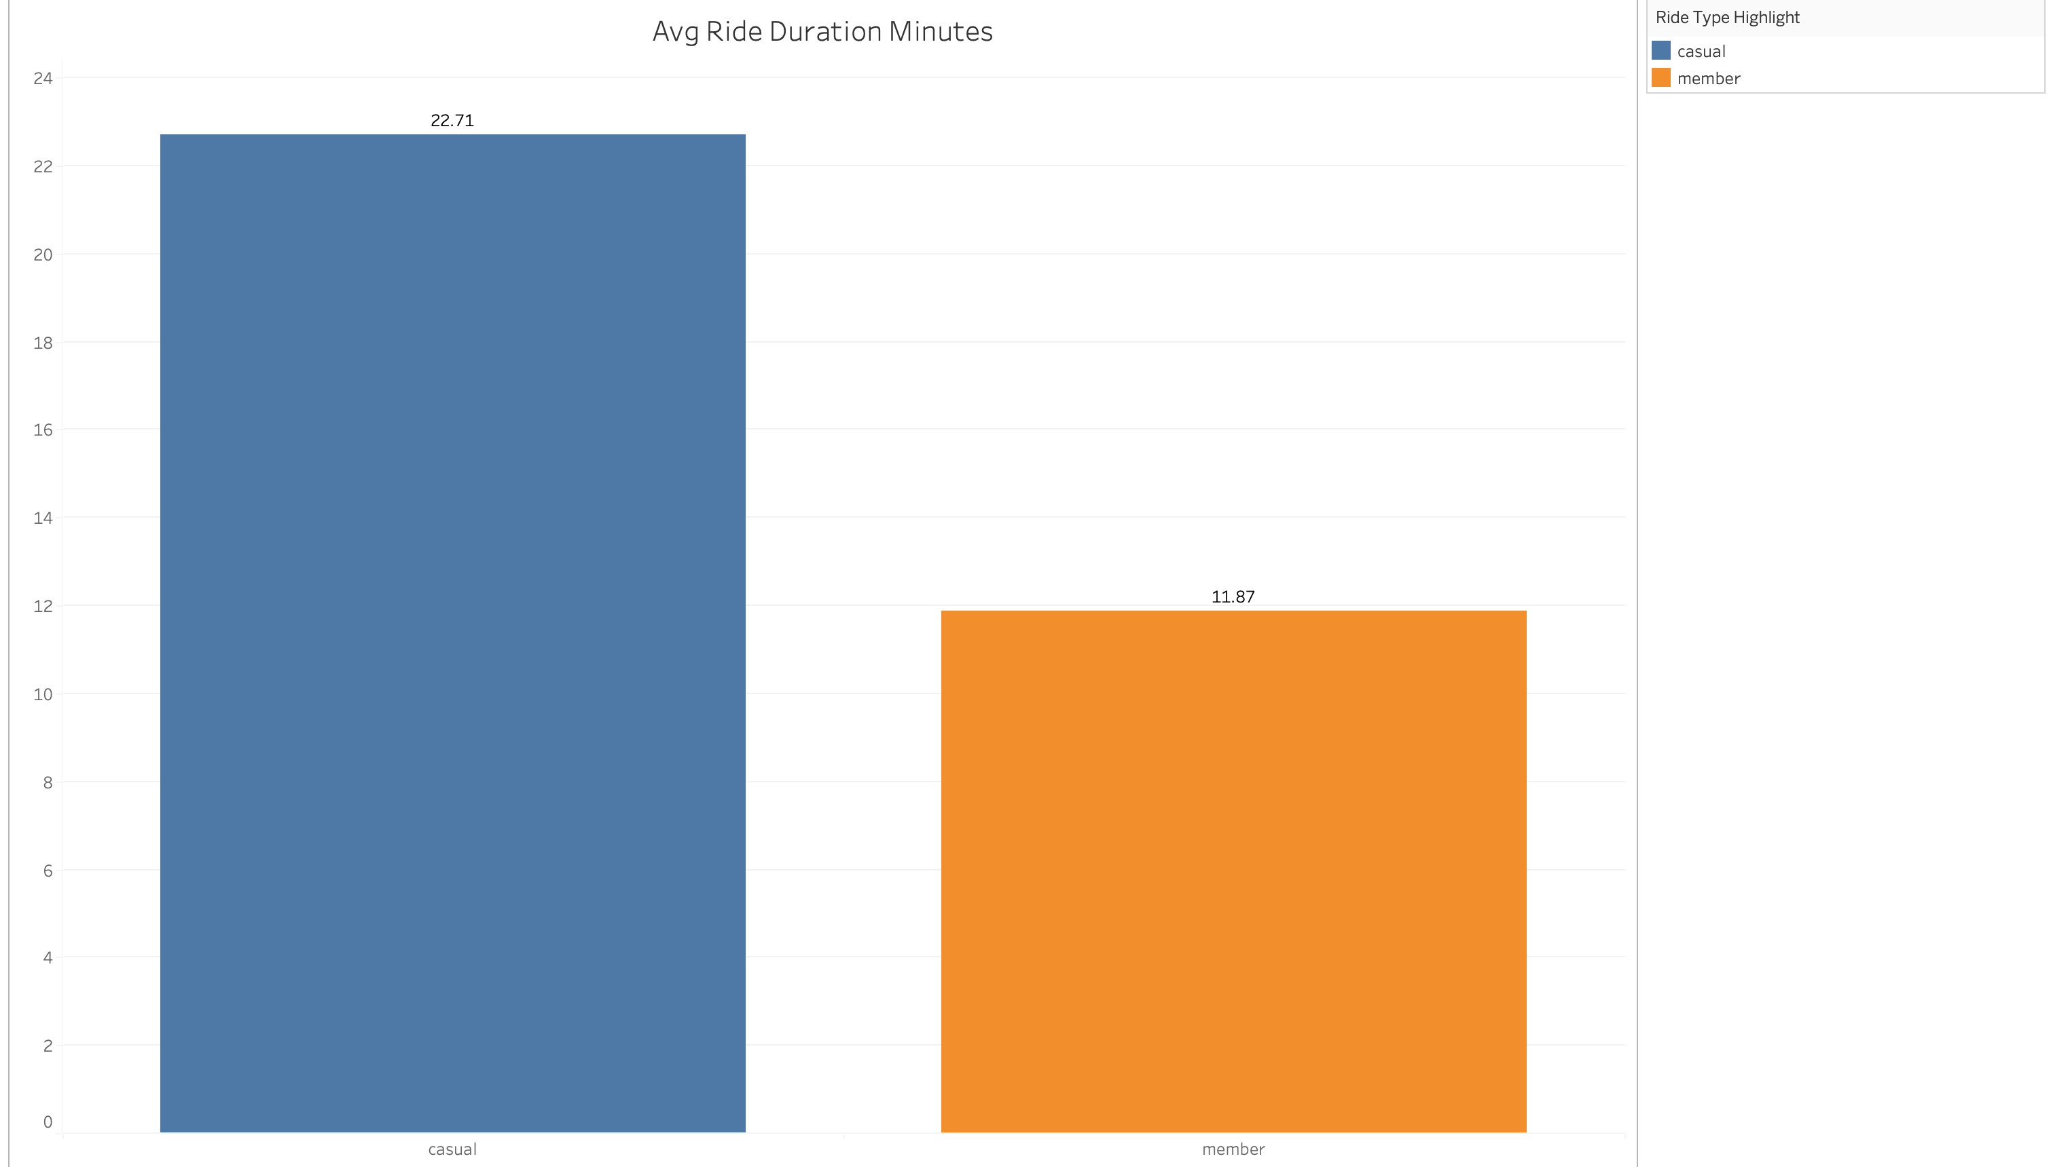
Members on average have shorter rides than casuals
Casual Average Ride duration 22.71 minutes
Member average ride duration 11.87 minutes

Slide 8
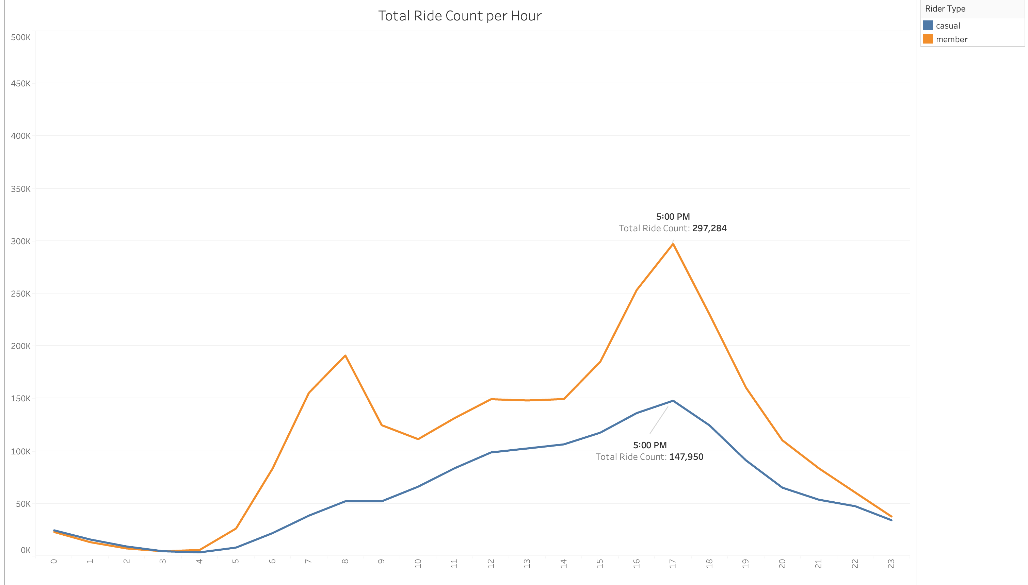
Members are most likely commuting to and from work
Members have peak ride times at 8:00 AM and 5:00 PM
Casuals only have a peak at 5:00 PM

Slide 9
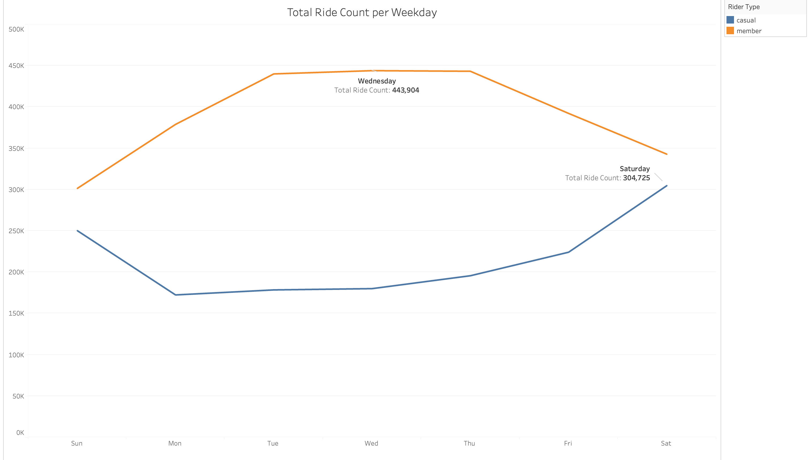
Casual and member riders have inverse ride preferences
Members most likely ride for midweek work commutes
Casuals most likely ride for weekend leisure

Slide 10
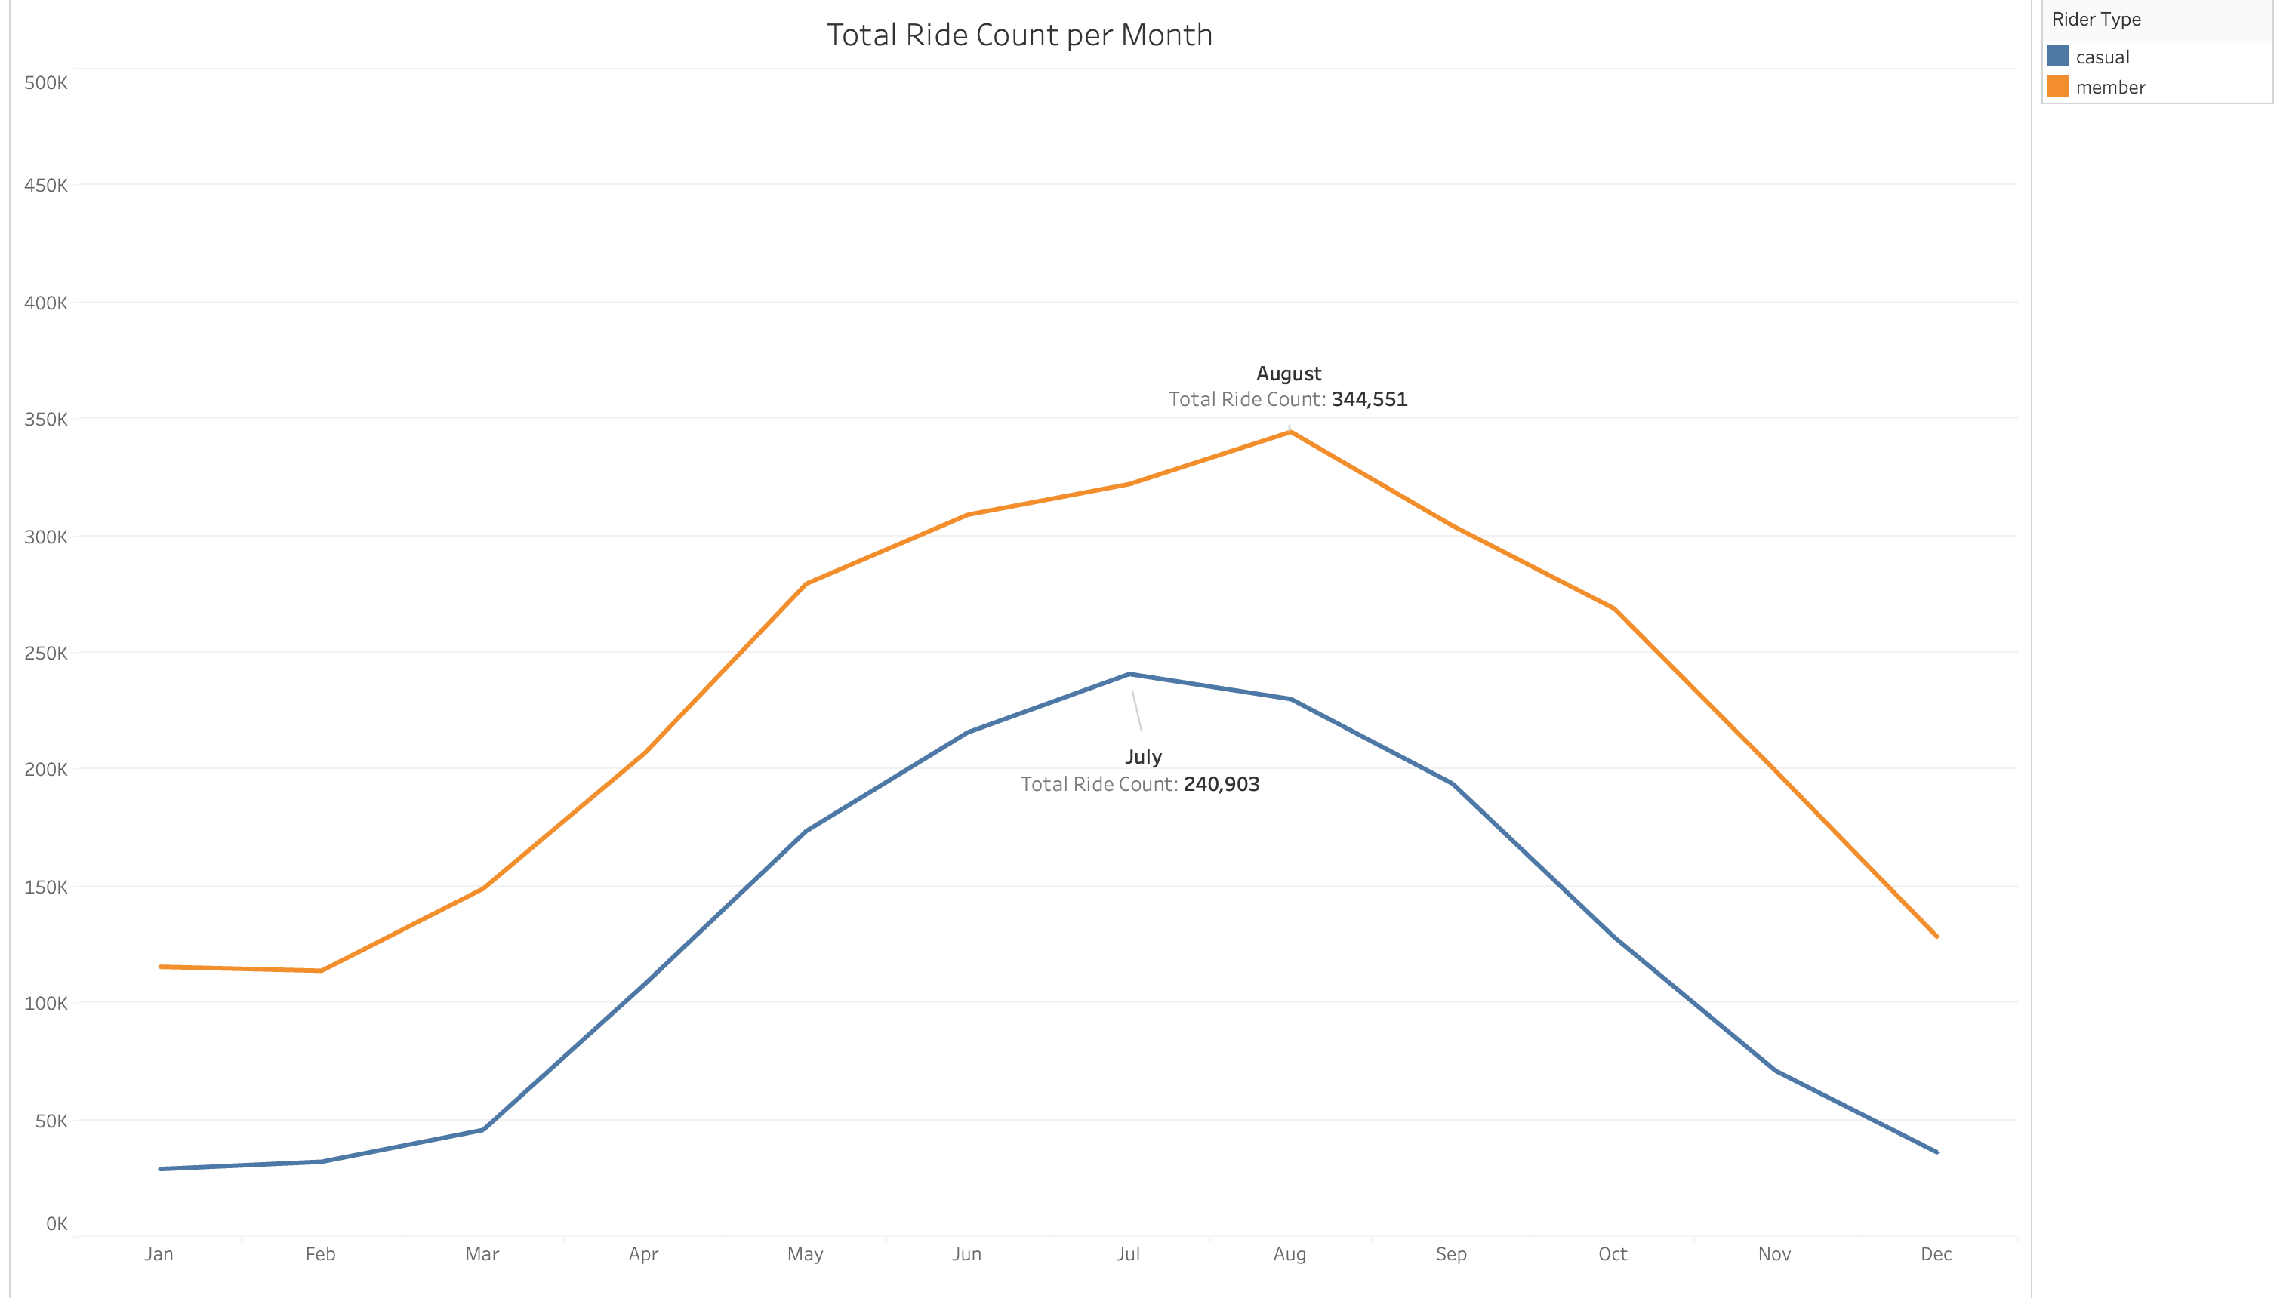
Both Casuals and Member ride peak in the warmer summer months and fall off during the colder winter months

Slide 11
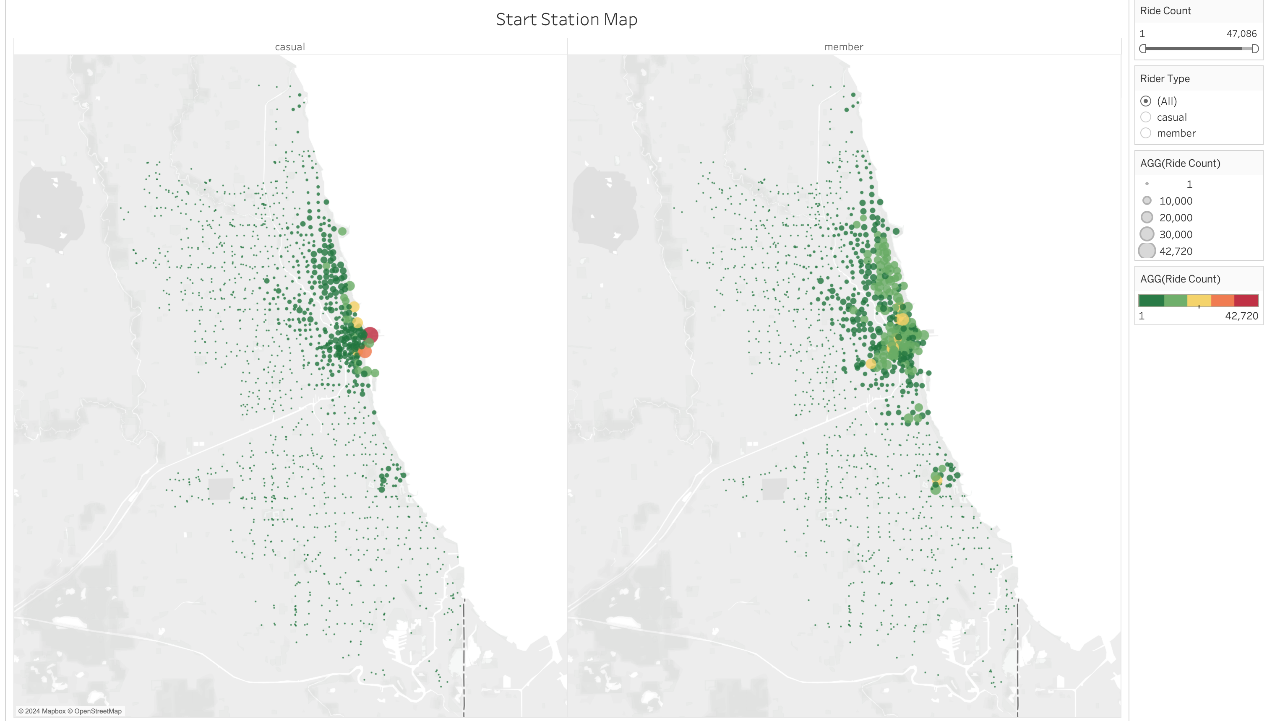
Casuals have more concentrated start stations
Members have more spread out start stations

Slide 12
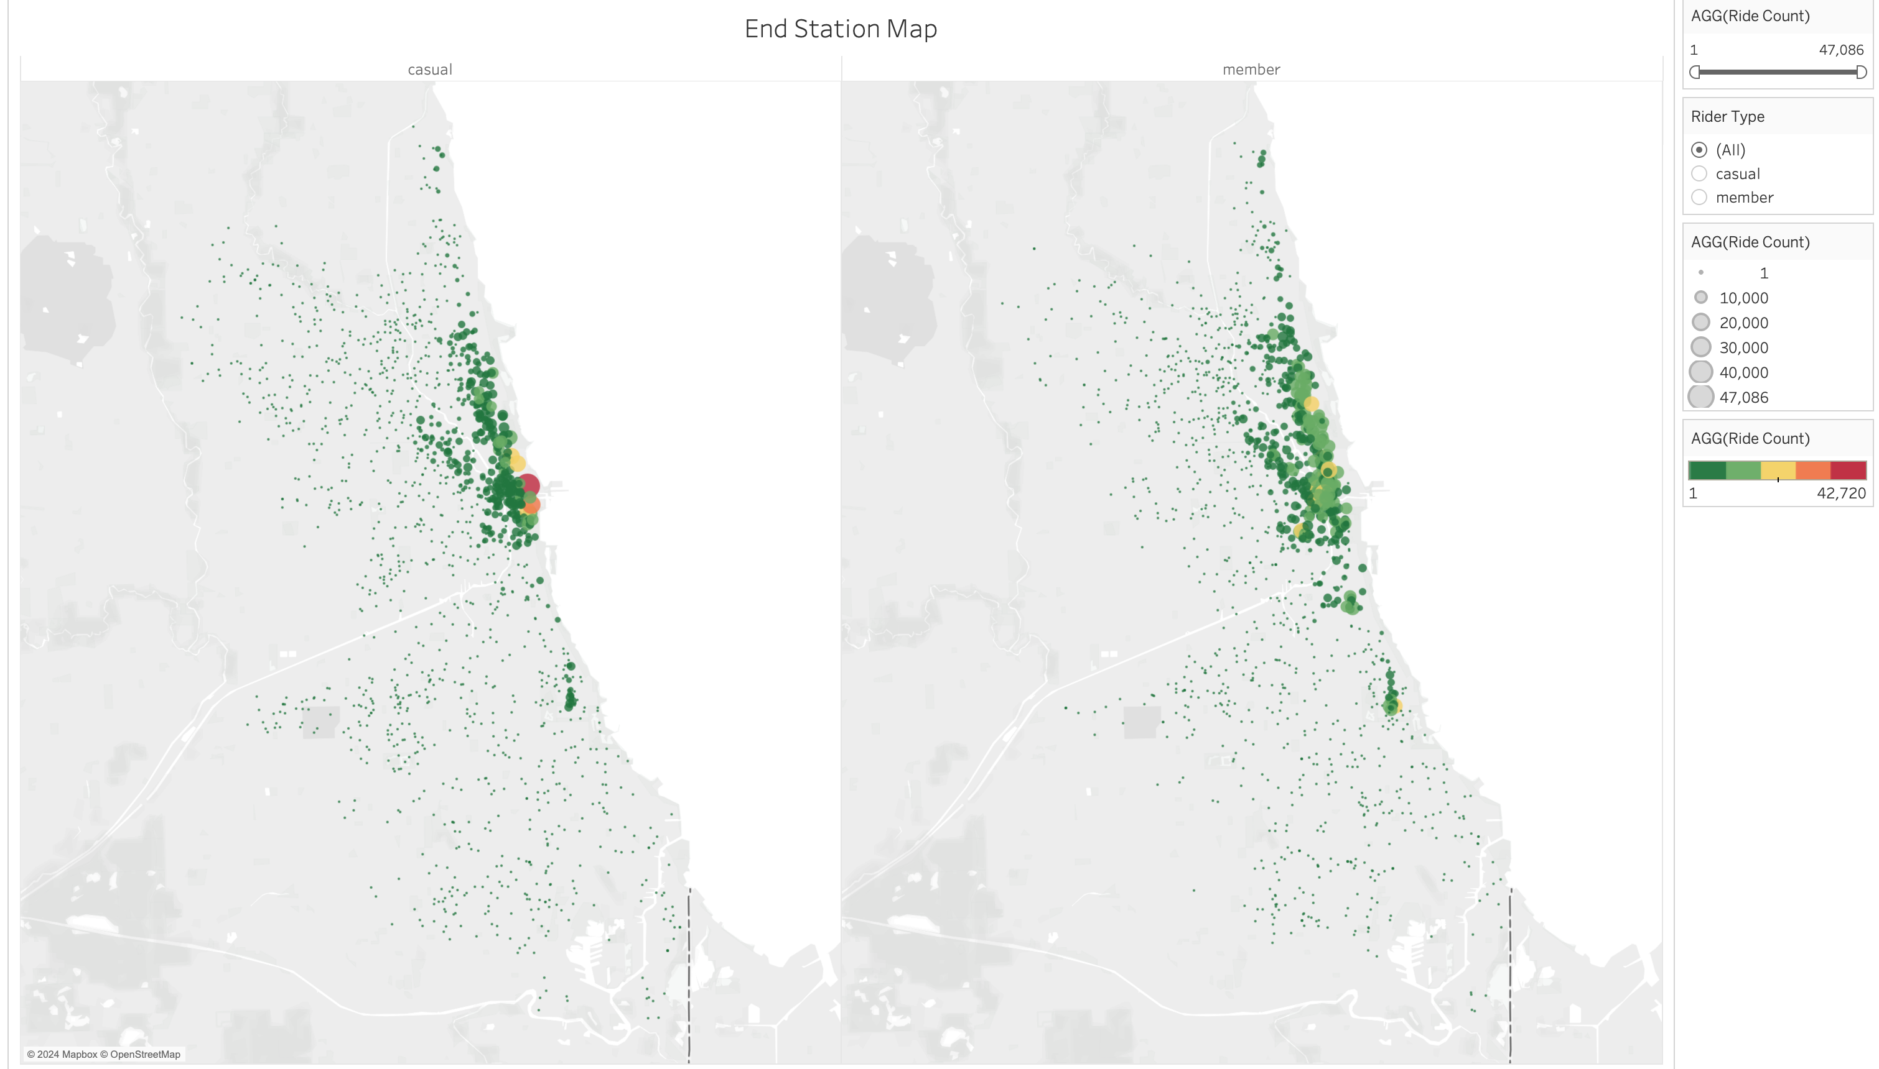
Casuals have more concentrated end stations
Members have more spread out end stations

Slide 13
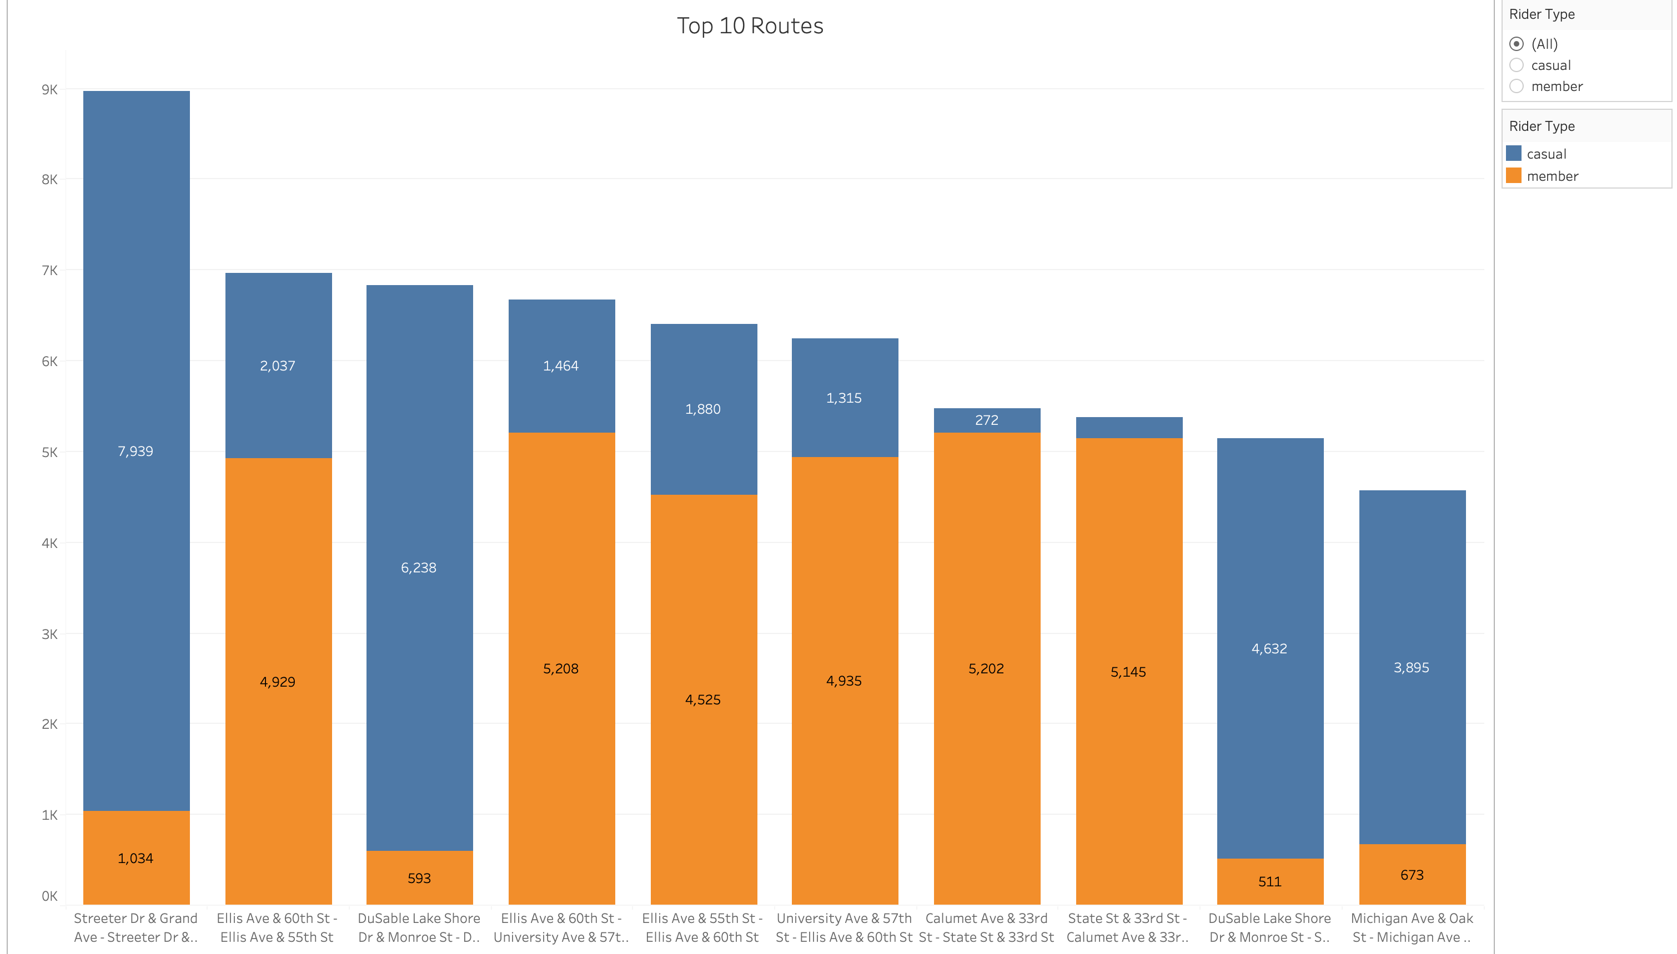
Most popular Casual Ride routes have the same start and end location
Most popular Member ride routes have different start and end stations

Slide 14
Top 3 Recommendations to convert Casual Riders to Annual Members

Slide 15
1. During the Summer Months, offer a discount on the annual membership Since summer are busiest months, casual riders may opt to purchase an annual membership if they plan on riding a lot during the summer

Slide 16
2. Display advertising in & around popular casual stations Popular casual stations such as Streeter Dr/Grand Ave and DuSable Lake Shore Dr/Monroe St offer high visibility to casual riders

Slide 17
3. Increase casual price during the weekends to incentivize membership purchases Since weekends are the most popular casual days, casual riders may opt for an annual membership if the daily prices are going to be higher on the weekends

